Slide 1

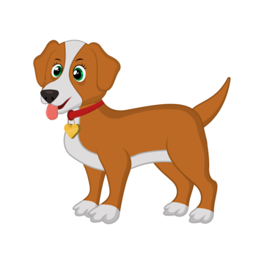






SCI 11

Slide 2
Ellis Dann
The Project Idea
The idea for our project is to develop an AI to accurately identify dog breeds.
The primary milestones for the project include:
Finding an appropriate dataset that we can use to train the AI
Using the appropriate algorithms as well as the dataset we found to train the AI
Creating a simple and easy to understand user interface for our users and finally
Remove bugs and optimise.
To find an appropriate dataset we plan on searching through various websites such as Roboflow and Kaggle until we find a comprehensible dataset with multiple pictures of various dog breeds for us to use. This should be the simplest of all the milestones to achieve.
To train the AI we first need to do research into the potential libraries that we could use for the machine learning such as TensorFlow and then learn how to leverage these libraries to train our own AI.
To develop a user interface, we will use the python library Tkinter. The primary feature that needs to be included in the UI to make it simple to users is an image upload feature.
To ensure accuracy and reliability we will continue testing and training our AI whilst making changes to optimise it. We will also vigorously test the UI to remove any bugs and ensure reliability for our users.

Slide 3
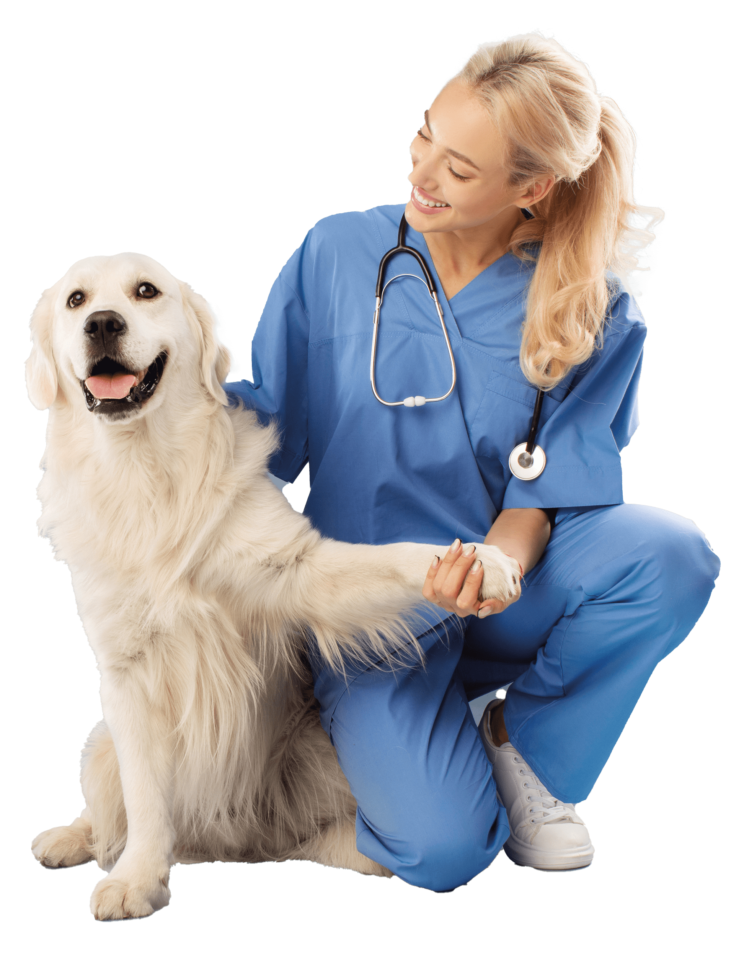
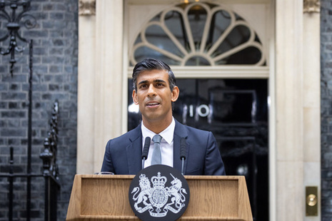
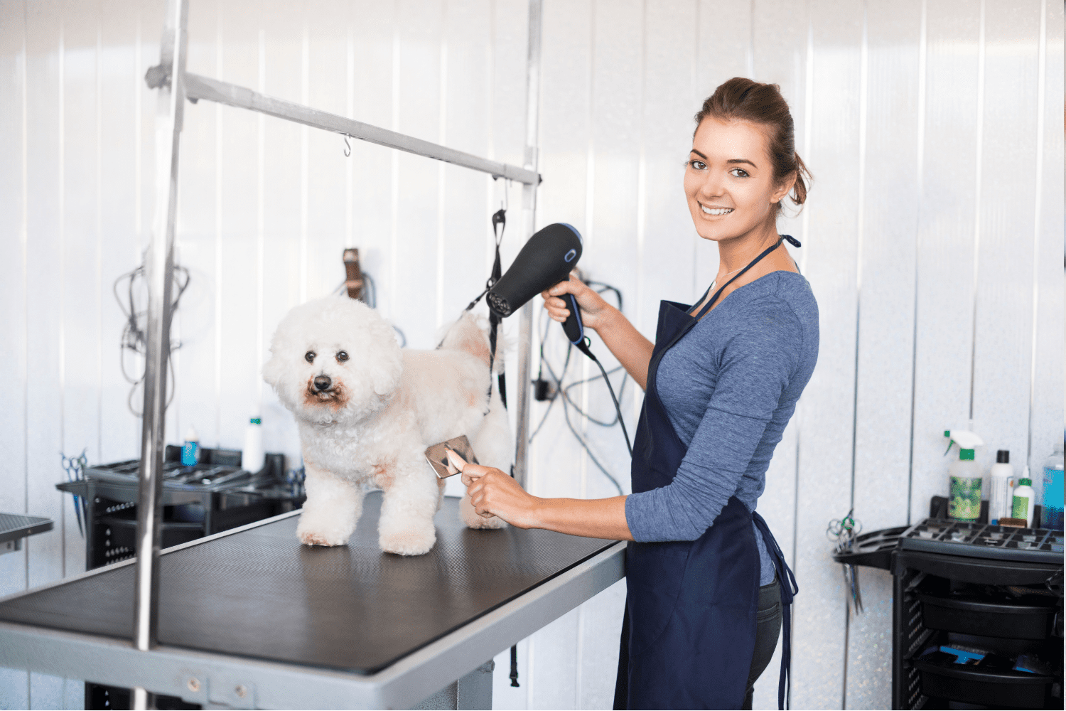
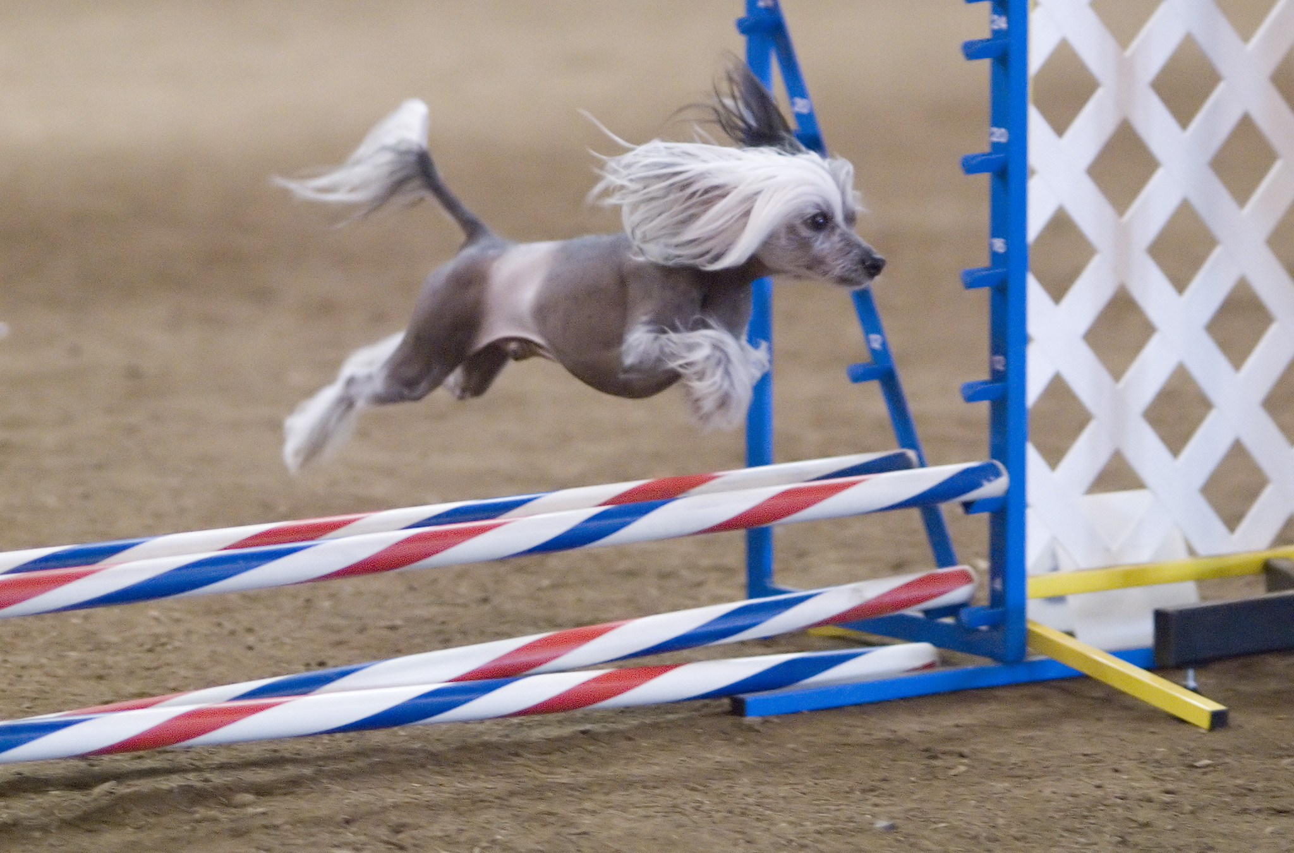
Joseph Kemp
The Applications
There are many practical applications of our application, such as, use in the veterinary field. For example, it can be used to identify dogs when they have been admitted to the vet and the owner is not 100% sure on the breed. This could be crucial as different breeds have different reactions to some medication. Our application would allow for vets to be sure to administer the correct medication to every dog. The app can also be used in veterinary training. This is by training students to better identify dogs by using random images and outputting the answer after they’ve guessed.
Pet stores, groomers and trainers could also use it to identify what dog they are selling/providing a service for. As well as this dog shelters could use it to identify stays and get them the correct help that they could desperately need.
It could also be used in various competitions so that the registration process is more streamlined, and the wrong dog isn’t put into the wrong competition. Ensuring a level playing field.
It can even be used by the government to check whether a dog is a breed that is illegal in that country.

Slide 4
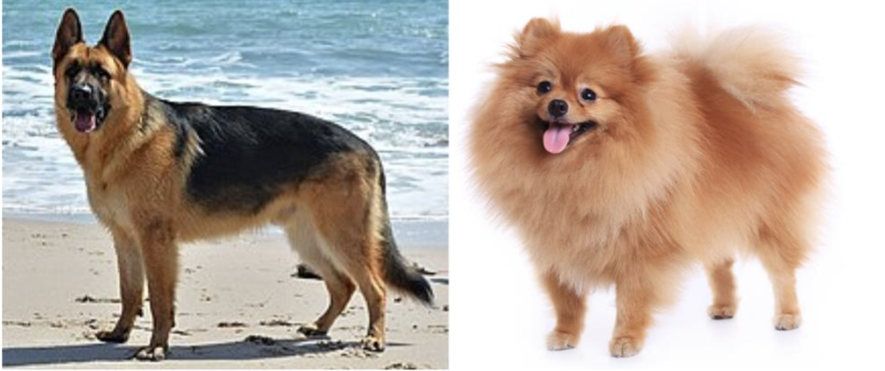
Daniel Arnold
Challenges in dog breed identification
· Finding a large enough dataset
To accurately distinguish breeds you need a large dataset. Lots of dogs are quite similar so without it the program would never get a high certainty
· Most dog breeds are easy to distinguish between E.G:
It is obviously very easy for us to recognize the difference between a German shepherd and a Pomeranian. Very distinct breeds are all easy to recognize by our program.
· The problems only happen when the characteristics of the breeds are very similar E.G a Malamute and a Husky.
Depending on the image this may course the program to not get the correct answer or not too particularly certain about it. To mitigate this problem we have tried to get the largest data set we could to improve the accuracy of the predications. Training it for an increased amount of time may also help but that would be limited by the training data at some point.

Slide 5
Patrick Bonk
Ethics & Considerations
Data Privacy, Usage & Consent
The project must adhere to strict ethical and professional standards. The method of obtaining the data should be legal and fully transparent. The UI includes a feature permitting users to upload their own images for classification. Thus, disclaimers have been integrated into the UI to warn users of uploading potentially sensitive data. Users should be made aware that any images uploaded may be used to further train the model.
Eliminating Bias
There are many ways in which bias may manifest, and it is the groups job to ensure to eliminate those biases. Ideally, the project should move beyond simple dog recognition and classification. Alongside the predictions, we would like to provide the user information about the dog that has been identified. This may include things such as the personality traits often attributed to a specific breed. When implementing this, we must ensure human bias is avoided, specifically any individual who implements information about a particular breed should avoid any independent preconceptions.
Documenting, Reporting and Engagement
The project scope should be clearly identified, including any specific goals and objectives. Any imperfections should be clearly identified to the users. For example, some identifications may become inaccurate wherever an image of a mix-breed dog is used. The group should allow feedback from users, and utilize this feedback to enhance the model performance and UI usability.

Slide 6
Summary
The project idea is dog breed identification and classification. The data must be ethically and legally obtained from a trusted source.
The applications of this project may include training for veterinary sciences, allowing trainees to test their knowledge and become more familiar with certain dog breeds.
The challenges of this project will include using a data set expansive enough to when trained, should provide the most accurate identification.
The potential ethical issues and considerations of this project have been laid out. We must ensure data is gathered/utilized appropriately, and ethical standards should be followed.

